Slide 1

Electricity Forecast Austria
By Jonas Welt, Karim Ortner & Lorenz Johannes Schlosser
Notes:
karim

Slide 2
Contributions & GitHub
Jonas – Preprocessing, Code architecture, Refactoring
Karim – dataset aquisition, documentation, presentation, visualization (EDA)
Lorenz - dataset aquisition, project structure, model selection, visualization
Github: https://github.com/LSchlosser/TIS3_CapstoneProject/tree/main/data
Notes:
karim

Slide 3
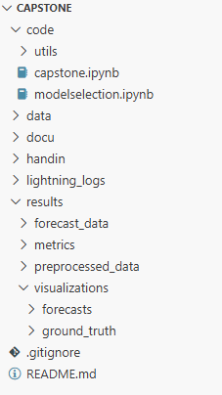
GitHub – Folder Structure
Notes:
jonas

Slide 4

Business Problem
Problem
Austrian electricity prices fluctuate daily due to supply-demand, renewable generation, and market dynamics.
This makes forward cost planning and procurement timing challenging.
Forecasting helps:
Utilities: improve procurement planning and budget accuracy
Businesses: anticipate seasonal energy cost changes and plan operations accordingly
Policymakers: gain forward-looking price signals to support cost monitoring and planning
Value
Monthly price forecasts provide directional price visibility, enabling more proactive decision-making and reducing reliance on reactive responses to price volatility
Notes:
karim

Slide 5
Solution
Steps Taken:
Data Engineering
Exploratory Data Analysis
Feature Engineering
Modeling
Evaluation
Forecast
Notes:
lorenz

Slide 6

Data source & description
Source: European wholesale electricity price data (daily)
Link: https://ember-energy.org/data/european-wholesale-electricity-price-data/
Scope: Austria
Variables: Date, Price (EUR/MWh)
Processing: Aggregate daily → monthly averages, add lagged/additional features
Notes:
lorenz

Slide 7
Data Engineering
Filter data for AUT
Standardize schema to “unique_id”, “ds” & “y”
Two frequencies prepared:
Daily : original daily prices used to train daily forecasting models
Monthly : daily prices aggregated to monthly averages and used to train monthly forecasting models
Chronological split to prevent data leakage:
Training: data before January 2025
Validation: January–December 2025
Test: reserved for future evaluation (2026 onward)
Same split strategy applied to both daily and monthly datasets
Notes:
jonas

Slide 8
Data Engineering
For Evaluation:
Daily forecasts aggregated to monthly averages for evaluation
Monthly models evaluated directly
Enables fair comparison of forecasting approaches
For Reproducibility:
Preprocessed data stored as CSV files
Cached loading for consistent results
Notes:
jonas

Slide 9
Insights
Historical trends & seasonality (higher prices in winter, lower in summer)
Spikes are short-lived → market shock events
Clear year-over-year upward trend, especially after 2021 (energy crisis)
Holiday periods can distort demand (e.g., Christmas, New Year)
Notes:
karim

Slide 10
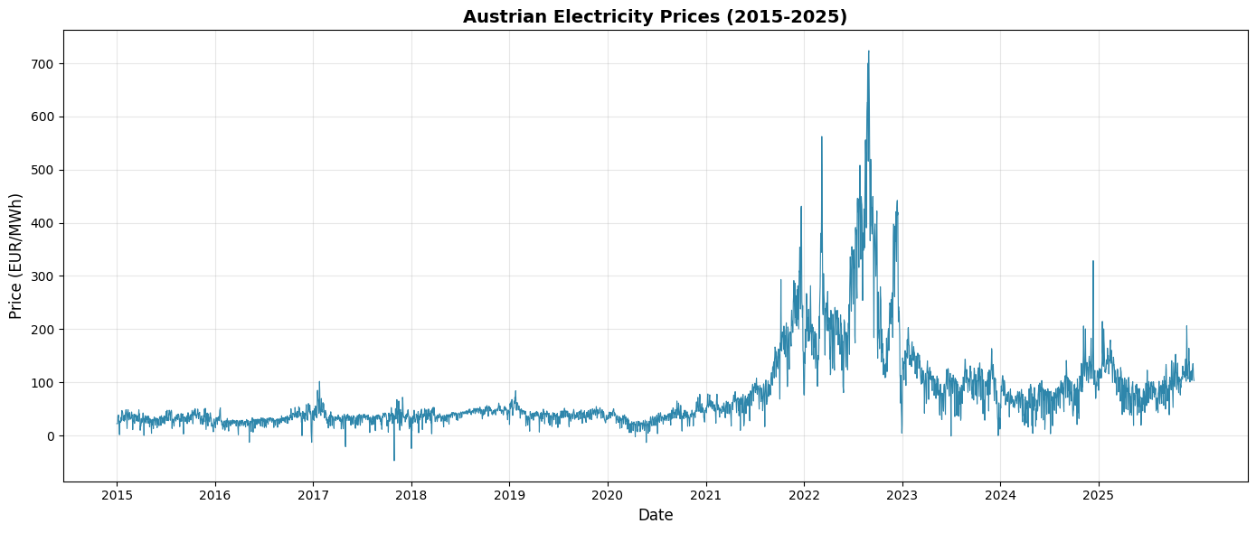
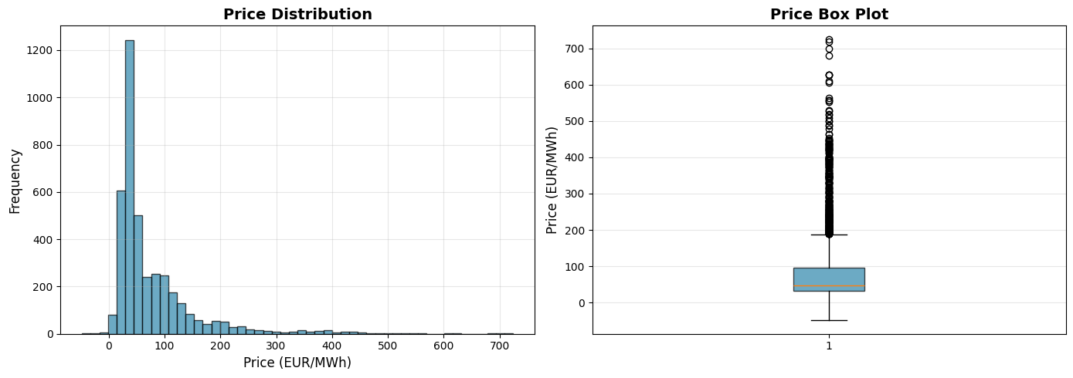
Insights
Notes:
karim

Slide 11
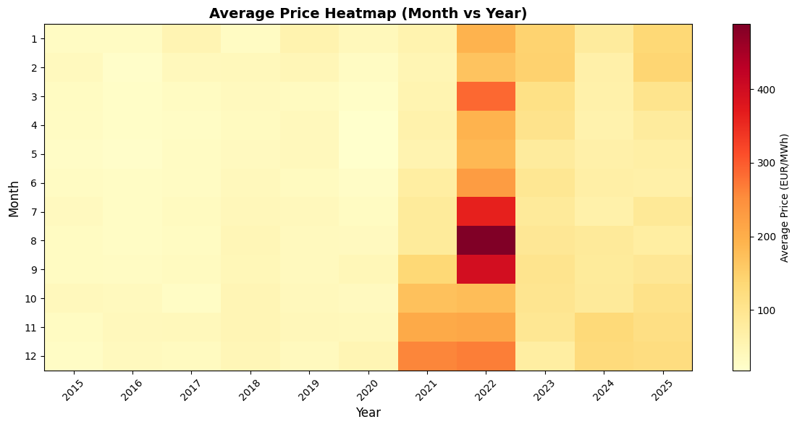
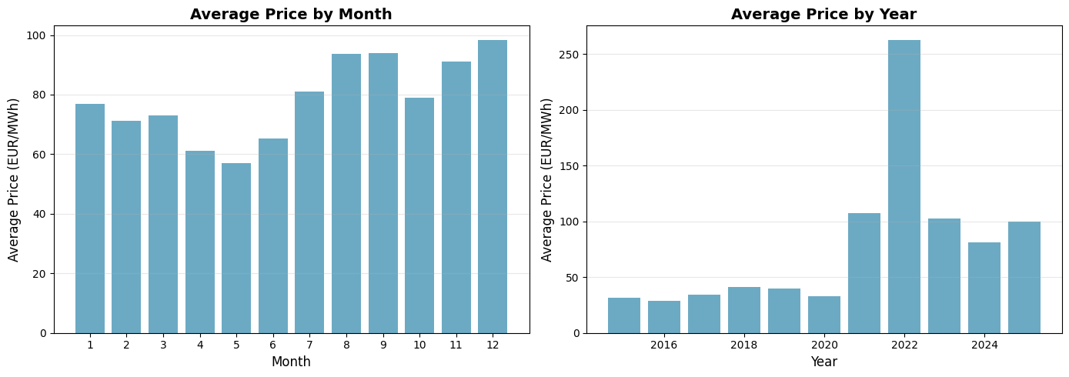
Insights
Notes:
karim

Slide 12
Feature Engineering
Capture temporal dependencies and seasonal effects
Different features for daily and monthly models
Enables models to learn short-term dynamics and long-term trends
Notes:
lorenz

Slide 13
Feature Engineering
Feature Type | Daily Features | Monthly Features
Lags | 1 day, 1 week, 4 weeks, 1 year | Last month, last quarter, half-year, last year
Rolling stats | 7-day mean, 30-day mean | 3-month mean, 12-month mean
Holiday | Binary indicator for public holidays | Monthly aggregated holiday counts
Date features | Day of week, month, quarter | Month, quarter
Lag-based rolling stats | Short-term volatility, weekly/monthly smoothing | Same transformations at monthly scale
Notes:
lorenz

Slide 14
Modeling
Model Type | Examples | Purpose / Notes
Baseline | Seasonal Naive, Random Walk w/ Drift, Historic Average, Structural | Simple, interpretable, computationally cheap; sets performance floor
Statistical | SES, Holt, Holt-Winters, AutoETS | Capture trend and seasonality efficiently; balance simplicity and sophistication
Machine Learning | Linear Regression, Huber Regressor, Random Forest, LGBM | Learn non-linear patterns and feature interactions; lag-enhanced version includes lags, rolling stats, holidays
Deep Learning | NHITS, KAN, RNN, LSTM | Capture complex, hierarchical, and long-term temporal patterns; daily vs monthly input sizes and horizons adapted
Four paradigms: Baseline, Statistical, Machine Learning, Deep Learning
Separate training for daily and monthly frequencies
Chronological training preserves temporal structure
Notes:
jonas

Slide 15
Evaluation
Forecasts compared to actuals on validation split
Daily forecasts aggregated to month for alignment with monthly metrics
Metric | Purpose
WAPE | Measures total absolute error relative to total actual demand, stable when values vary in scale
MAE | Average absolute deviation (EUR/MWh), robust to spikes
RMSE | Penalizes large errors, highlights models avoiding big misses
MAPE | Scale-free %, facilitates comparison across periods; careful with low values
Notes:
jonas

Slide 16
Evaluation
Only forecast columns used for scoring; identifier/date columns excluded
Missing values dropped before scoring
Results sorted by MAPE and saved as CSVs for reproducibility
Model selection through MAPE
Visual diagnostics: predicted vs actual, residuals, prediction intervals
Notes:
jonas

Slide 17
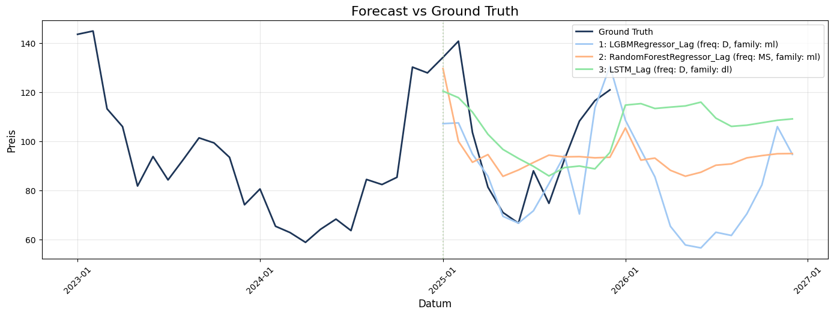
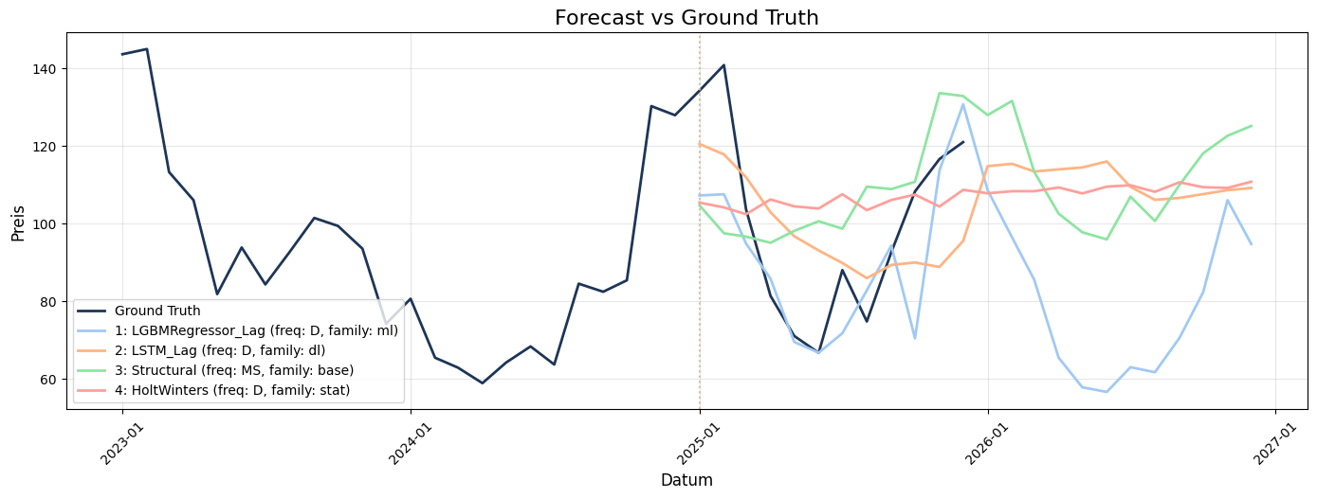
Forecast
Notes:
lorenz

Slide 18
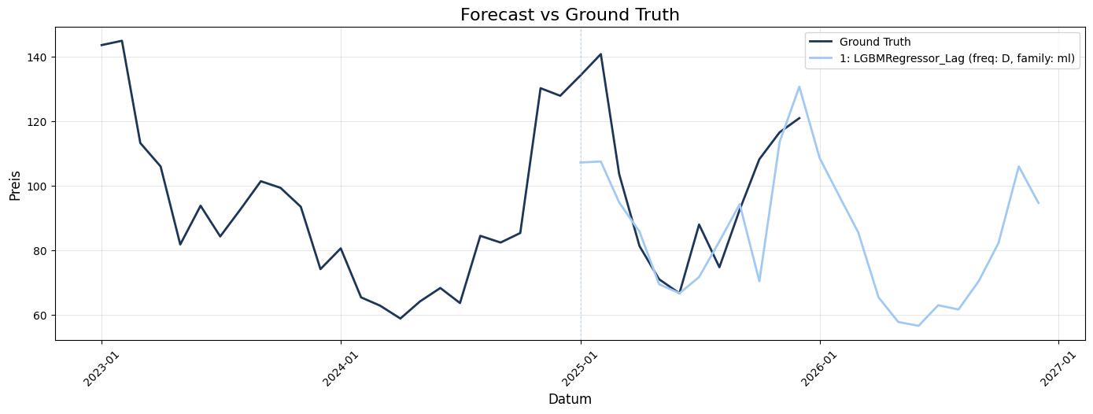
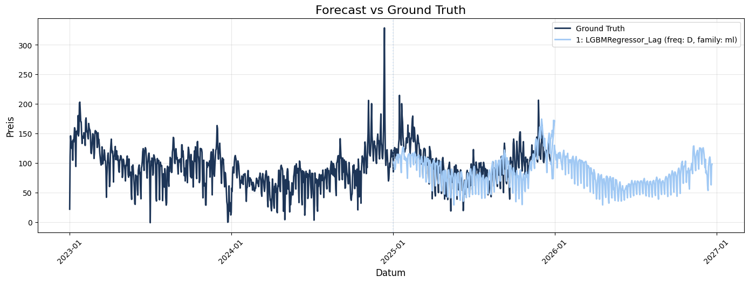
Forecast
Notes:
lorenz

Slide 19
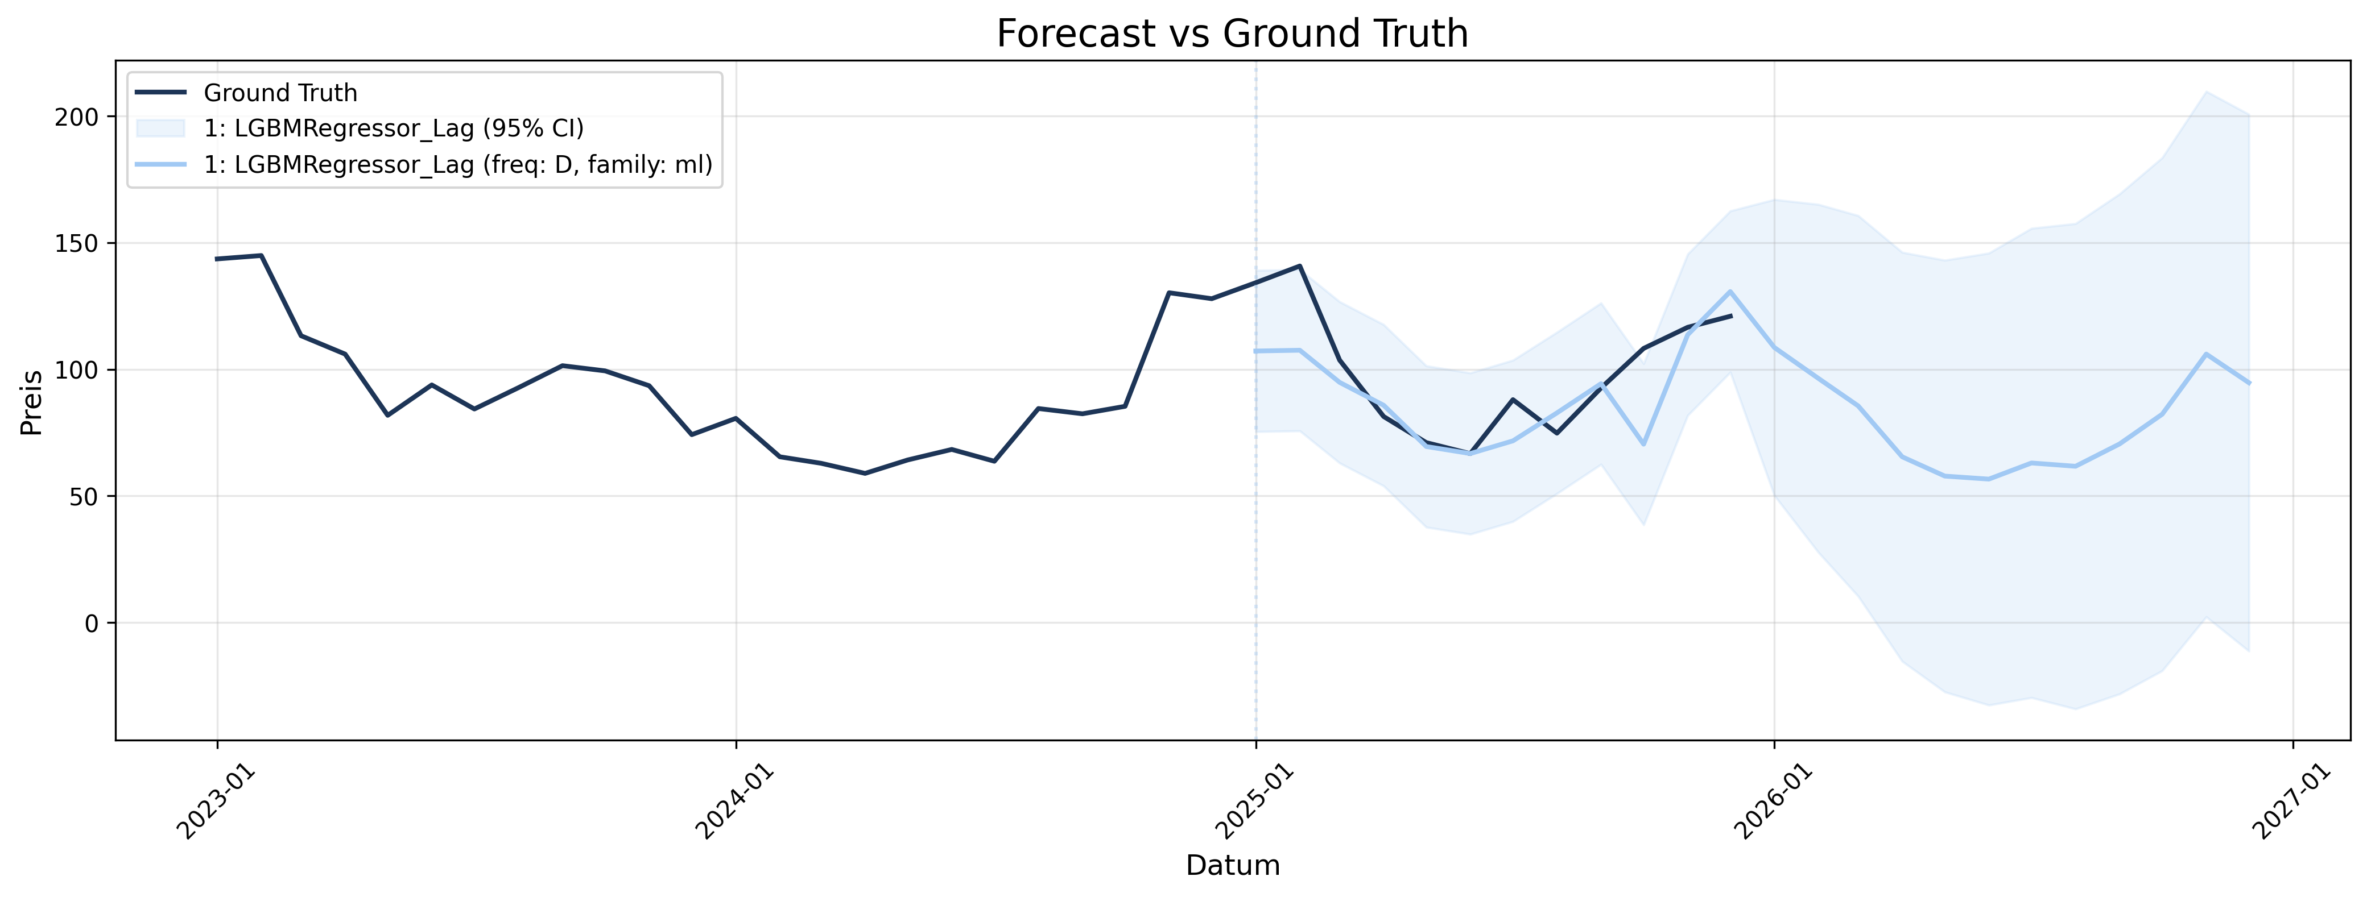
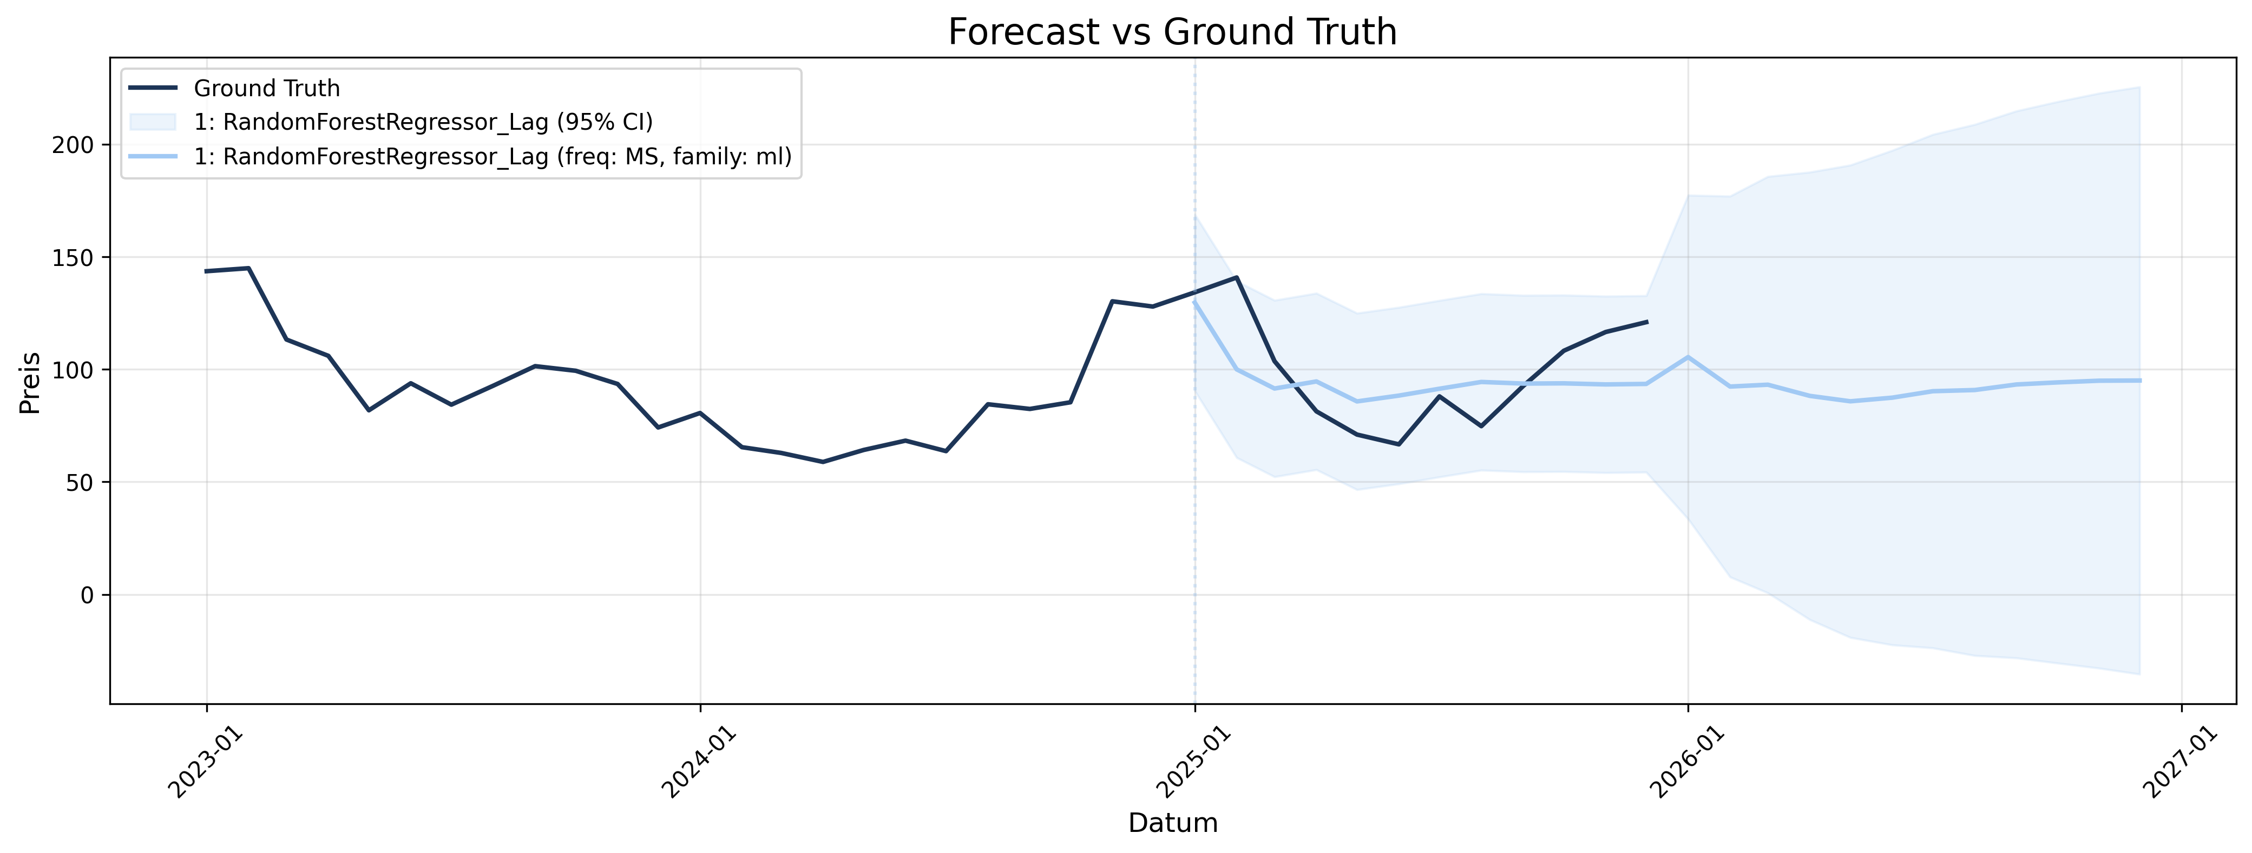
Forecast
Notes:
lorenz

Slide 20
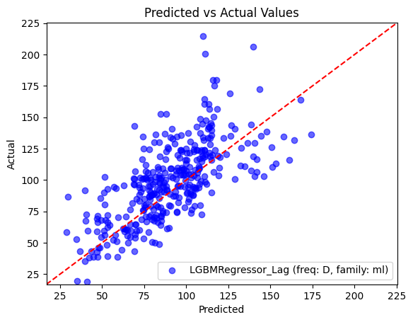
Forecast
Notes:
lorenz

Slide 21
Value/ Decision-Making
Actions enabled:
Schedule energy procurement in advance
Adjust trading strategies
Optimize energy-intensive production
Impact:
Reduced costs due to better planning
Mitigate risks from price spikes
Without forecasts → reactive decisions, higher costs
Notes:
karim

